Slide 1
Chapter 13
How to work with forms

Slide 2
Objectives
Applied
Use HTML to create a form that includes any of the form controls, including the HTML5 controls.
Use CSS to format a form and its controls.
Use the HTML5 attributes and CSS3 selectors for data validation.
Use an HTML form to add a search function to a website.
Knowledge
Describe the use of an HTML form for initiating client-side processing or submitting data to a web server.
Describe the get and post methods that can be used to submit a form.
Describe the use of any of the form controls.
Describe the use of tab order and access keys.

Slide 3
Objectives (continued)
Describe the use of these HTML5 attributes: autocomplete, required, and pattern.
Describe the use of regular expressions.
Describe the use of a datalist.
Describe the use of a form that provides a search function for a website.

Slide 4
Attributes of the form element
id
action
method
target

Slide 5
Attributes common to most input elements
type
id
name
disabled
readonly

Slide 6
The HTML for a form
<form id="email_form" action="subscribe.php"
method="post">
<p>Please enter your e-mail address to subscribe to our newsletter.</p>
<p>E-Mail: <input type="text" name="email"></p>
<p><input type="submit" id="submit" value="Subscribe"></p>
</form>

Slide 7
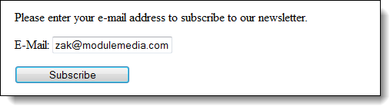
The form in a web browser

Slide 8
The URL that’s used when the form is submitted with the get method
subscribe.php?email=zak%40modulemedia.com&submit=Subscribe

Slide 9
Attributes of the input element for buttons and for the button element
type
value
src
alt
height
width

Slide 10
Four buttons that are created by the input element
<input type="button" id="message" value="Alert Me">
<input type="submit" id="checkout" value="Checkout">
<input type="reset" id="resetform" value="Reset">
<input type="image" src="images/submit.jpg" alt="Submit button" width="114" height="42">

Slide 11
A button that is created by the button element
<button type="submit">
<img src="images/addtocart.png" width="30" height="23" alt="Add to Cart">Add to Cart
</button>

Slide 12
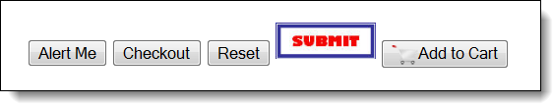
The buttons in a web browser

Slide 13
Attributes of the input element for text fields
type
value
maxlength
size
autofocus
placeholder

Slide 14
The HTML for text fields
Quantity:<input type="text" name="quantity" value="1"
size="5" readonly><br><br>
Username:<input type="text" name="username" autofocus><br><br>
Password:<input type="password" name="password“
maxlength="6" placeholder="Enter your password"><br><br>
Hidden:<input type="hidden" name="productid“
value="widget">

Slide 15
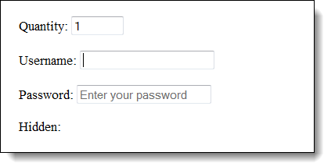
The text fields in a web browser

Slide 16
The HTML for radio buttons and check boxes
Crust:<br>
<input type="radio" name="crust" value="thin"> Thin Crust<br>
<input type="radio" name="crust" value="deep" checked> Deep Dish<br>
<input type="radio" name="crust" value="hand"> Hand Tossed<br><br>
Toppings:<br>
<input type="checkbox" name="topping1" value="pepperoni"> Pepperoni<br>
<input type="checkbox" name="topping2" value="mushrooms"> Mushrooms<br>
<input type="checkbox" name="topping3" value="olives"> Olives

Slide 17
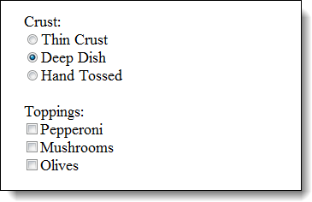
The radio buttons and check boxes in a web browser

Slide 18
The HTML for a drop-down list
Style:<br>
<select name="style_and_size">
<optgroup label="The New Yorker">
<option value="ny10">10"</option>
<option value="ny12">12"</option>
<option value="ny16">16"</option>
</optgroup>
<optgroup label="The Chicago">
<option value="chi10">10"</option>
<option value="chi12">12"</option>
<option value="chi16">16"</option>
</optgroup>
</select>

Slide 19
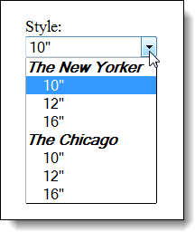
The drop-down list in a web browser when the user clicks on the arrow

Slide 20
The HTML for a list box
<select name="toppings" size="4" multiple>
<option value="pepperoni">Pepperoni</option>
<option value="sausage" selected>Sausage</option>
<option value="mushrooms">Mushrooms</option>
<option value="olives">Black olives</option>
<option value="onions">Onions</option>
<option value="bacon">Canadian bacon</option>
<option value="pineapple">Pineapple</option>
</select>

Slide 21
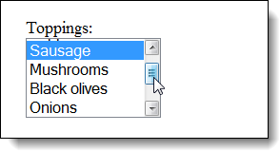
The list box in a web browser with a scroll bar

Slide 22
The HTML and CSS for a text area
The HTML
Comments:<br>
<textarea name="comments" placeholder="If you have any comments, please enter them here.">
</textarea>
The CSS
textarea {
height: 5em;
width: 25em;
font-family: Arial, Helvetica, sans-serif; }

Slide 23
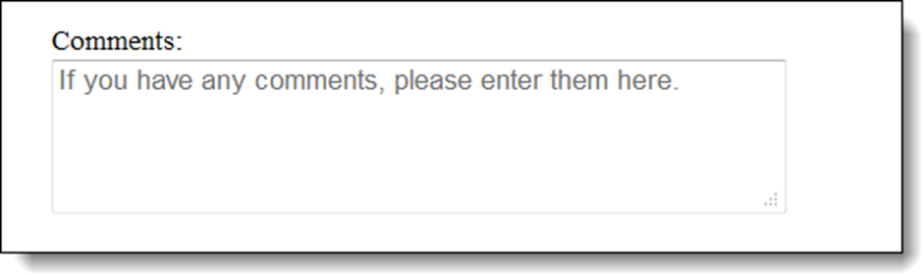
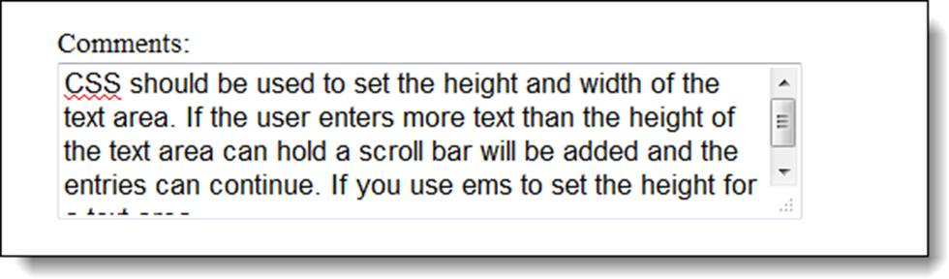
The text area in a web browser
The text area after text has been entered

Slide 24
The HTML for a form with label elements
<label for="quantity">Quantity:</label>
<input type="text" name="quantity" id="quantity" value="1" size="5"><br><br>
Crust:<br>
<input type="radio" name="crust" id="crust1" value="thin">
<label for="crust1">Thin Crust</label><br>
<input type="radio" name="crust" id="crust2" value="deep">
<label for="crust2">Deep Dish</label><br>
...<br><br>
Toppings:<br>
<input type="checkbox" name="topping1" id="topping1" value="pepperoni">
<label for="topping1">Pepperoni</label><br>
<input type="checkbox" name="topping2" id="topping2" value="mushrooms">
<label for="topping2">Mushrooms</label><br>
...<br><br>

Slide 25
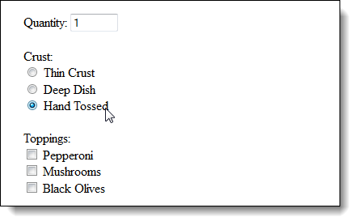
The HTML in a browser as the user clicks on a label to check its box

Slide 26
Accessibility guideline
Use labels with radio buttons and check boxes so the user can click on the label text to select the control that the label is associated with.
This also helps assistive devices.

Slide 27
HTML that uses fieldset and legend elements
<form id="order" action="order.php" method="post">
<fieldset>
<legend>Crust</legend>
<input type="radio" name="crust" id="crust1" value="thin">
<label for="crust1">Thin Crust</label><br>
<input type="radio" name="crust" id="crust2" value="deep">
<label for="crust2">Deep Dish</label><br>
...
</fieldset>
<br>
<fieldset>
<legend>Toppings</legend>
<input type="checkbox" name="topping1" id="topping1" value="pepperoni">
<label for="topping1">Pepperoni</label><br>
...
</fieldset>

Slide 28
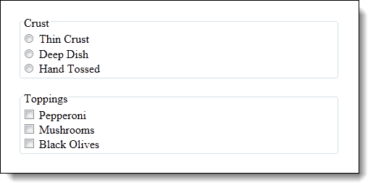
The elements in a web browser

Slide 29

The HTML for a file upload control that accepts JPEG and GIF images
<form name="upload_form" action="sendemail.php" method="post" enctype="multipart/form-data">
Attach an image:<br>
<input type="file" name="fileupload" accept="image/jpeg, image/gif">
</form>
The file upload control in the Chrome browser

Slide 30
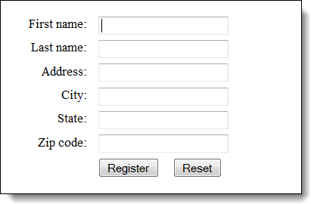
Label, text box, and button controls aligned on a form

Slide 31
The HTML for the form
<label for="firstname">First name:</label>
<input type="text" name="firstname" id="firstname" autofocus><br>
<label for="lastname">Last name:</label>
<input type="text" name="lastname" id="lastname"><br>
<label for="address">Address:</label>
<input type="text" name="address" id="address"><br>
<label for="city">City:</label>
<input type="text" name="city" id="city"><br>
<label for="state">State:</label>
<input type="text" name="state" id="state"><br>
<label for="zip">Zip code:</label>
<input type="text" name="zip" id="zip"><br>
<input type="submit" id="button" value="Register">
<input type="reset" id="reset">

Slide 32
The CSS for the controls
label {
float: left;
width: 5em;
text-align: right;}
input {
margin-left: 1em;
margin-bottom: .5em;}
#button {
margin-left: 7em;}

Slide 33
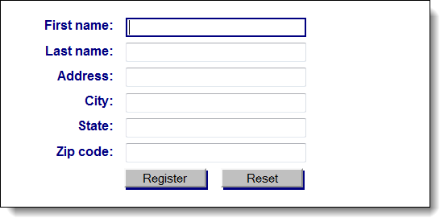
The form with some additional formatting

Slide 34
The CSS for the form with formatting
body {
font: 90% Arial, Helvetica, sans-serif;
margin: 20px; }
label {
color: navy;
float: left;
width: 8em;
font-weight: bold;
text-align: right;}
input {
width: 15em;
margin-left: 1em;
margin-bottom: .5em;}
input:focus {
border: 2px solid navy; }
#button, #reset {
width: 7em;
box-shadow: 2px 2px 0 navy;
background-color: silver; }
#button { margin-left: 9.5em; }

Slide 35
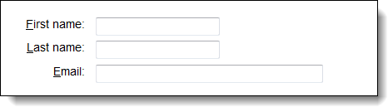
Three labels with access keys
The HTML for the controls
<label for="firstname"><u>F</u>irst name:</label>
<input type="text" name="firstname" id="firstname"
accesskey="F"><br>
<label for="lastname"><u>L</u>ast name:</label>
<input type="text" name="lastname" id="lastname"
accesskey="L"><br>
<label for="email"><u>E</u>mail:</label>
<input type="text" name="email" id="email"
accesskey="E">

Slide 36
Another way to define the access keys
<label for="firstname" accesskey="F"><u>F</u>irst name:</label>
<input type="text" name="firstname" id="firstname"><br>
<label for="lastname" accesskey="L"><u>L</u>ast name:</label>
<input type="text" name="lastname" id="lastname"><br>
<label for="email" accesskey="E"><u>E</u>mail:</label>
<input type="text" name="email" id="email">

Slide 37
Accessibility guideline for tab order and access keys
Setting a proper tab order and providing access keys improves the accessibility for users who can’t use a mouse.

Slide 38
The HTML5 attributes for data validation
autocomplete
required
novalidate
formnovalidate

Slide 39
HTML that uses some of the validation attributes
Name: <input type="text" name="name" required><br>
Address: <input type="text" name="address><br>
Zip: <input type="text" name="zip" required><br>
Phone: <input type="text" name="phone" required autocomplete="off"><br>
<input type="submit" name="submit" value="Submit Survey">

Slide 40
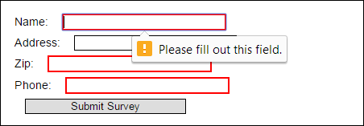
Error message and highlighting in Chrome

Slide 41
The CSS3 pseudo-classes for required, valid, and invalid fields
:required
:valid
:invalid

Slide 42
A CSS attribute selector for all controls with the required attribute
input[required]

Slide 43
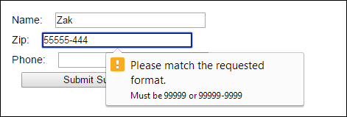
HTML that uses regular expressions
Name: <input type="text" name="name" required autofocus><br>
Zip: <input type="text" name="zip" required
pattern="\d{5}([\-]\d{4})?"
title="Must be 99999 or 99999-9999"><br>
Phone: <input type="text" name="phone" required
pattern="\d{3}[\-]\d{3}[\-]\d{4}"
title="Must be 999-999-9999"><br>
<input type="submit" id="submit" value="Submit Survey">
The form in Chrome

Slide 44
HTML that uses a datalist element
<p>Our company is conducting a survey. Please answer the question below.</p>
<label for="link">What is your preferred search engine: </label>
<input type="url" name="link" id="link" list="links">
<datalist id="links">
<option value="http://www.google.com/" label="Google">
<option value="http://www.yahoo.com/" label="Yahoo">
<option value="http://www.bing.com/" label="Bing">
<option value="http://www.ask.com/" label="Ask">
</datalist>
<br><br>
<input type="submit" id="submit" value="Submit Survey">

Slide 45
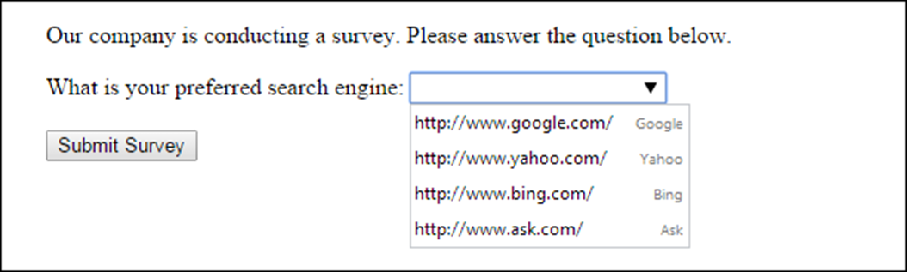
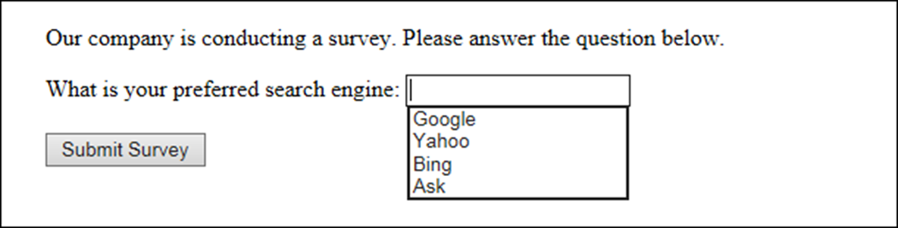
The datalist in Chrome with its down arrow clicked
The datalist in IE with the focus on it

Slide 46
HTML code that uses the email, url, and tel controls
<form id="email_form" action="survey.php" method="post">
<h3>Your information:</h3>
<label for="email">Your email address:</label>
<input type="email" name="email" id="email" required><br>
<label for="link">Your website:</label>
<input type="url" name="link" id="link" list="links"><br>
<label for="phone">Your phone number:</label>
<input type="tel" name="phone" id="phone" required><br><br>
<input type="submit" id="submit" value="Submit Survey">
</form>

Slide 47
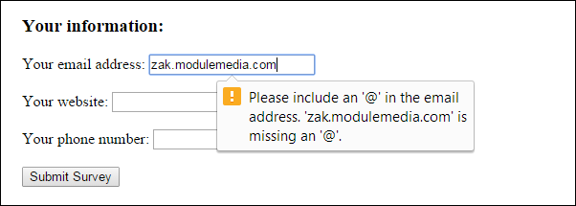
The form with email, url, and tel controls in Chrome

Slide 48
HTML that uses number and range controls
<h3>Your information:</h3>
<form id="test_form" action="test.php" method="get">
<label for="investment">Monthly investment: </label>
<input type="number" name="investment" id="investment" id="investment" min="100" max="1000" step="100" value="300"><br><br>
<label for="book">Rate the book from 1 to 5: </label>
<input type="range" name="book" id="book"
min="1" max="5" step="1"><br><br>
<input type="submit" id="submit" value="Submit Survey">
</form>

Slide 49
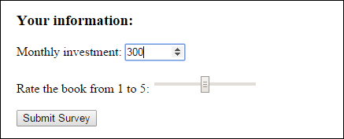
The form in with number and range controls in Chrome

Slide 50
HTML that uses the date and time controls
Date and time:&nbsp;&nbsp;
<input type="datetime" name="datetime"><br><br>
Local date and time:&nbsp;&nbsp;
<input type="datetime-local" name="datetimelocal"><br><br>
Month:&nbsp;&nbsp;
<input type="month" name="month"><br><br>
Week:&nbsp;&nbsp;
<input type="week" name="week"><br><br>
Time:&nbsp;&nbsp;
<input type="time" name="time"><br><br>
Date:&nbsp;&nbsp;
<input type="date" name="date">

Slide 51
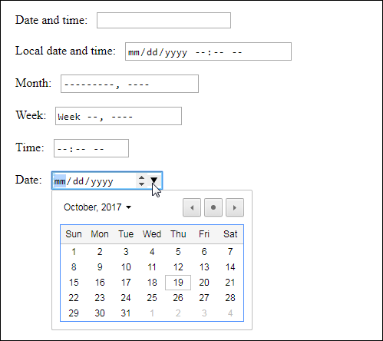
The controls in Chrome

Slide 52

A search function that uses a search control in the Chrome browser

Slide 53
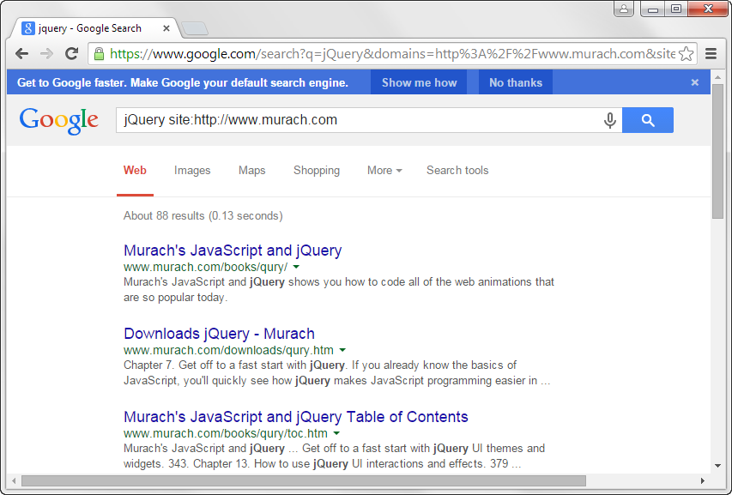
The results of a search when Google is used

Slide 54
The HTML for using the Google search engine
<form method="get" action="http://www.google.com/search">
<input type="search" name="q" size="30" maxlength="255">
<input type="hidden" name="domains"
value="http://www.murach.com">
<input type="hidden" name="sitesearch"
value="http://www.murach.com">
<input type="submit" id="search" value="Search">
</form>

Slide 55

The HTML for a color control
<label for="firstcolor">Choose your first background color:</label>
<input type="color" name="firstcolor" id="firstcolor"
value="#facd8a">
The color control in Chrome

Slide 56
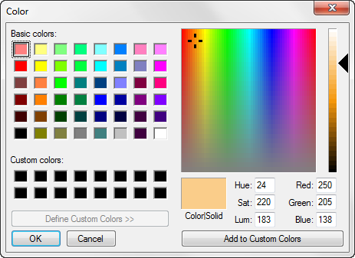
The Windows color palette

Slide 57
The HTML for a form that uses an output element
<p>Enter numbers in both fields and click the Calculate button.</p>
<form onsubmit="return false">
<input name="x" type="number" min="100" step="5" value="100"> +
<input name="y" type="number" min="100" step="5" value="100"><br><br>
<input type="button" value="Calculate"
onClick="result.value = parseInt(x.value) + parseInt(y.value)">
<br><br>
Total: <output name="result" for="x y"></output>
</form>

Slide 58
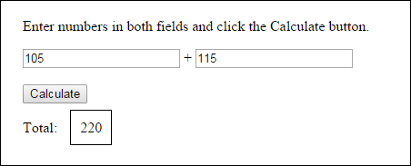
The form in Chrome with a border around the output element

Slide 59
Attributes for the progress and meter elements
high
low
min
max
optimum
value

Slide 60
The HTML for progress and meter elements
<body onLoad="setInterval(setProgressAndMeter, 500)">
<h3>Progress Element</h3>
Progress set by JavaScript on page load:
<progress id="progressBar" max="100" value="0"></progress>
<h3>Meter Element</h3>
Meter set by JavaScript on page load:
<meter id="meterBar" max="100" value="0" optimum="50" high="60"></meter>
</body>

Slide 61
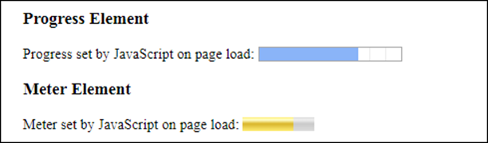
The progress and meter elements in Chrome

Slide 62
The JavaScript for progress and meter elements
<script>
function setProgressAndMeter() {
var progress = document.getElementById("progressBar");
progress.value += 10;
var meter = document.getElementById("meterBar");
meter.value += 10;
};
</script>

Slide 63
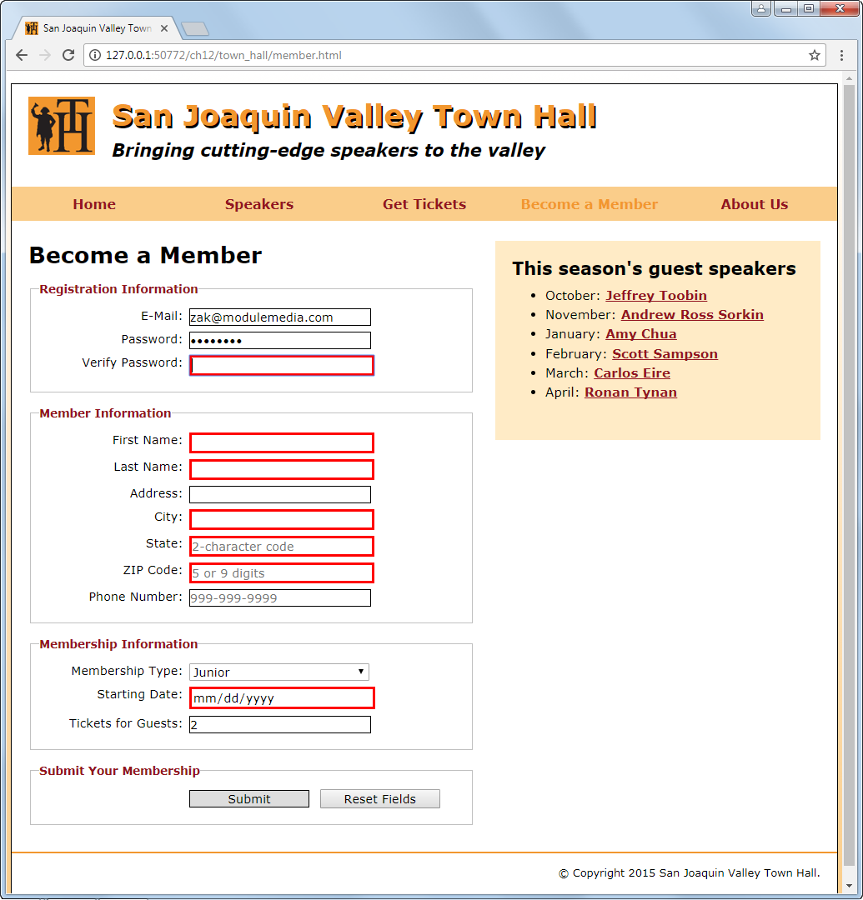
A form in Chrome that uses HTML5 validation

Slide 64
The HTML for the form (part 1)
<form action="register_account.html" method="get"
id="registration_form">
<fieldset>
<legend>Registration Information</legend>
<label for="email">E-Mail:</label>
<input type="email" name="email" id="email" autofocus required><br>
<label for="password">Password:</label>
<input type="password" name="password" id="password" required
placeholder="At least 6 letters or numbers"
pattern="[a-zA-Z0-9]{6,}"
title="Must be at least 6 alphanumeric characters"><br>
<label for="verify">Verify Password:</label>
<input type="password" name="verify" id="verify" required><br>
</fieldset>

Slide 65
The HTML for the form (part 2)
<fieldset>
<legend>Member Information</legend>
<label for="first_name">First Name:</label>
<input type="text" name="first_name" id="first_name" required><br>
...
...
...
<label for="state">State:</label>
<input type="text" name="state" id="state" required maxlength="2" placeholder="2-character code"><br>
<label for="zip">ZIP Code:</label>
<input type="text" name="zip" id="zip" required
placeholder="5 or 9 digits"
pattern="^\d{5}(-\d{4})?$" title="Either 5 or 9 digits"><br>
<label for="phone">Phone Number:</label>
<input type="tel" name="phone" id="phone"
placeholder="999-999-9999"
pattern="\d{3}[\-]\d{3}[\-]\d{4}"
title="Must be 999-999-999 format"><br>
</fieldset>

Slide 66
The HTML for the form (part 3)
<fieldset>
<legend>Membership Information</legend>
<label for="membership_type">Membership Type:</label>
<select name="membership_type" id="membership_type">
<option value="j">Junior</option>
<option value="r">Regular</option>
<option value="c">Charter</option>
</select><br>
<label for="starting_date">Starting Date:</label>
<input type="date" name="starting_date"
id="starting_date" required><br>
<label for="tickets">Tickets for Guests:</label>
<input type="number" name="tickets" id="tickets"
value="2" min="1" max="4" placeholder="from 1 to 4"><br>
</fieldset>
<fieldset id="buttons">
<legend>Submit Your Membership</legend>
<label>&nbsp;</label>
<input type="submit" id="submit" value="Submit">
<input type="reset" id="reset" value="Reset Fields"><br>
</fieldset>
</form>

Slide 67
The CSS for the form with HTML5 validation
fieldset {
margin-top: 1em;
margin-bottom: 1em;
padding-top: .5em;
}
legend {
color: #931420;
font-weight: bold;
font-size: 85%;
margin-bottom: .5em;
}
label, input, select {
font-size: 90%;
}
label {
float: left;
width: 12em;
text-align: right;
}

Slide 68
The CSS (continued)
input, select {
width: 15em;
margin-left: .5em;
margin-bottom: .5em;
}
input:required, input[required] {
border: 3px solid red;
}
input:valid {
border: 1px solid black;
}
input:invalid {
box-shadow: none;
}
br {
clear: both;
}
#buttons input {
width: 10em;
}

Slide 69
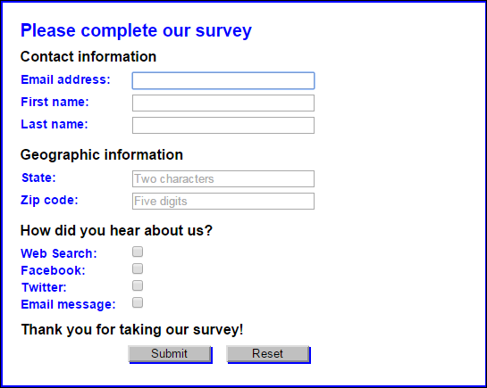
Short 13-1 Create a form

